Slide 1
BIKE DEMAND PREDICTION
P. Akshay Kumar
MT19094

Slide 2
Problem Statement
Predicting the number of bike rentals in Los Angeles on an hourly basis.
Datasets used:
Bike dataset: https://bikeshare.metro.net/about/data/
US weather dataset: https://www.kaggle.com/selfishgene/historical-hourly-weather-data
List of US Holidays dataset: https://www.kaggle.com/gsnehaa21/federal-holidays-usa-19662020

Slide 3
Preprocessing
Converting bike dataset into a format relevant for hourly bike demand prediction.
Rolling up of timestamp on hourly basis in every dataset.
Creation of new dataset corresponding to seasons.
Mapping weather description to index based on ideal weather for cycling.
New features such as ‘isWeekend’, 'hour_workingday_casual’ and 'hour_workingday_registered’ were created.

Slide 4
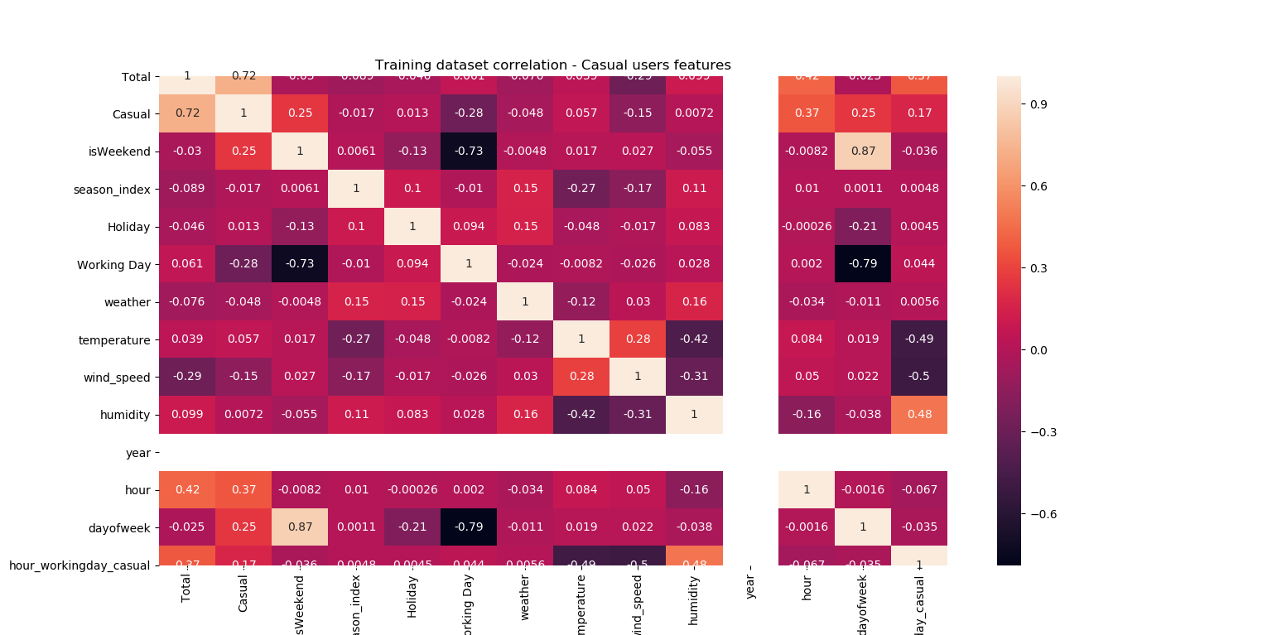
Feature selection
Correlation matrix – Casual users

Slide 5
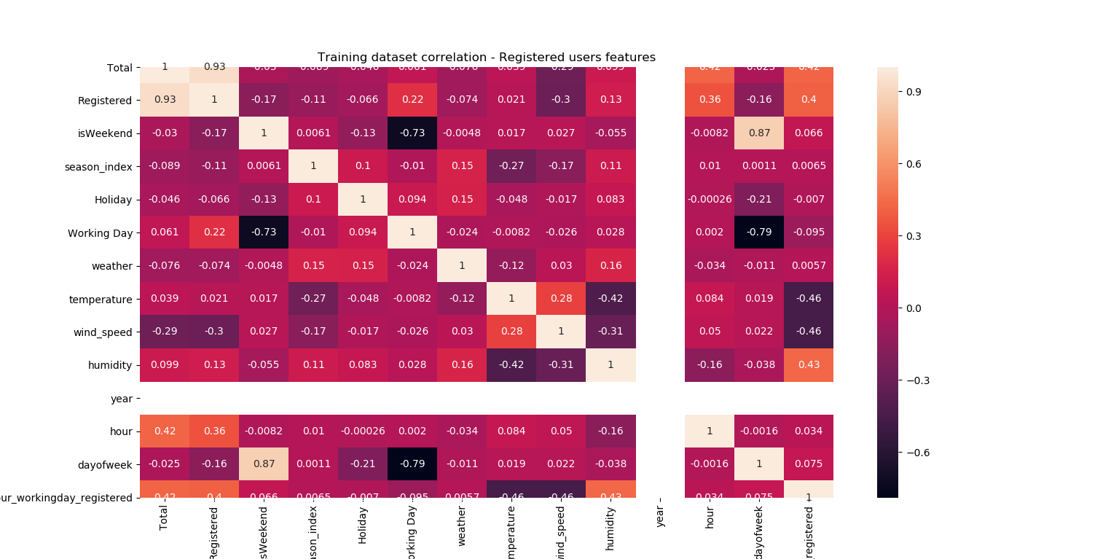
Feature selection
Correlation matrix – Registered users
Grid Search CV – Used for parameter tuning and best score.

Slide 6
Models used
Gradient Boost Regressor
Random Forest Regressor
XGBoost Regressor

Slide 7
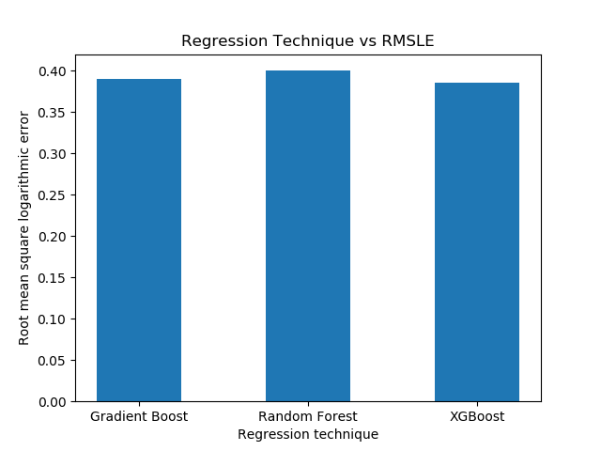
RMSLE vs Regression Techniques

Slide 8
Predicted Output
Datetime | Total
10/1/2017 0:00 | 14.1682
10/1/2017 1:00 | 9.203767
10/1/2017 2:00 | 5.428997
10/1/2017 3:00 | 3.062933
10/1/2017 4:00 | 2.487095
10/1/2017 5:00 | 2.084362
10/1/2017 6:00 | 3.764745
10/1/2017 7:00 | 7.697911
10/1/2017 8:00 | 15.71184
10/1/2017 9:00 | 26.90046
10/1/2017 10:00 | 40.5385
10/1/2017 11:00 | 46.39053
10/1/2017 12:00 | 51.93648
10/1/2017 13:00 | 57.64378
10/1/2017 14:00 | 56.84118
10/1/2017 15:00 | 57.5596
10/1/2017 16:00 | 65.00659
10/1/2017 17:00 | 65.13668
10/1/2017 18:00 | 61.09695
10/1/2017 19:00 | 45.68273
10/1/2017 20:00 | 31.02853
10/1/2017 21:00 | 20.6592
10/1/2017 22:00 | 14.97494
10/1/2017 23:00 | 8.815697

Slide 9
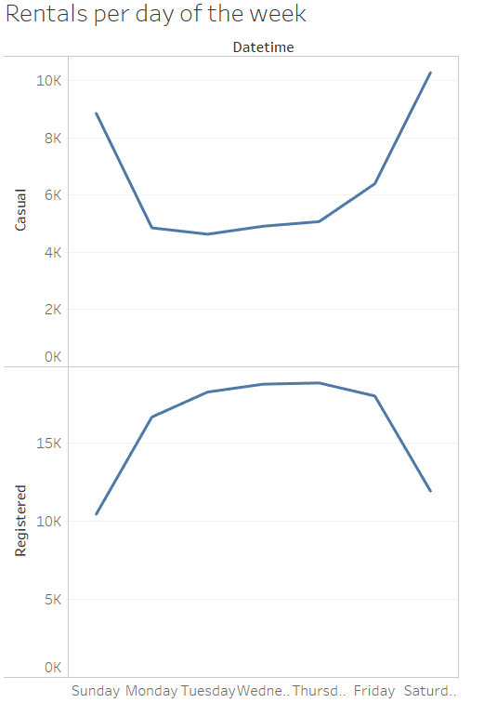
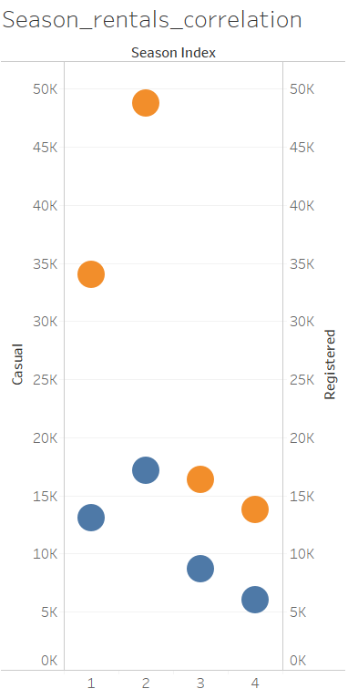
Data Visualization

Slide 10
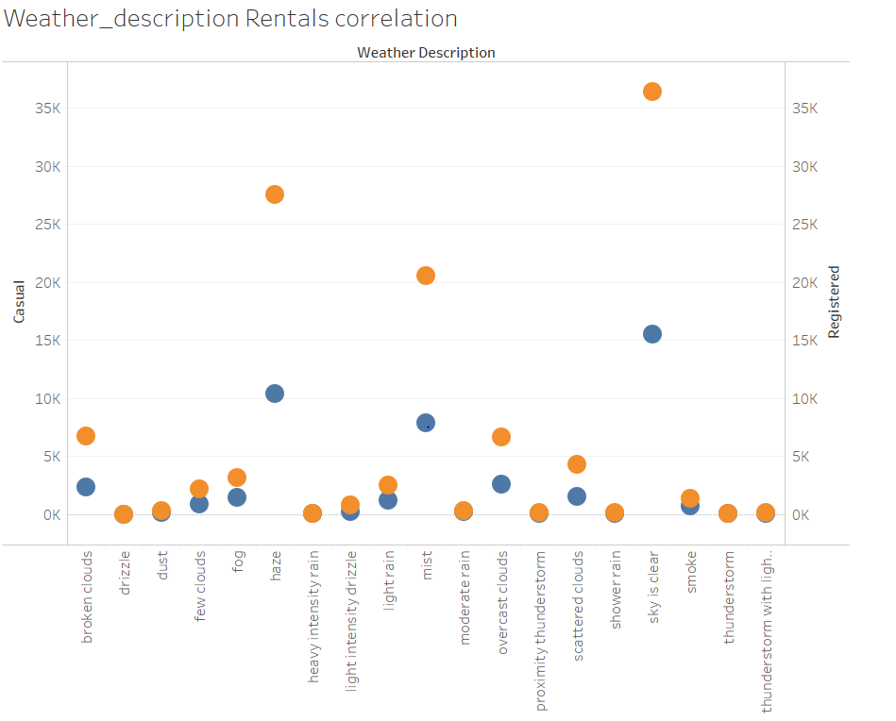
Data Visualization

Slide 11
THANK YOU

